Slide 1
Reactor Lunch Time Building an End to End Secure, Scalable IoT Serverless Solution
Dave Glover,
Microsoft Australia
Cloud Advocate
Follow me @dglover
https://github.com/gloveboxes/Integrate-IoT-Edge-Classifier-with-Python-Azure-Functions-and-Azure-SignalR

Slide 2
Comprehensive Set of Capabilities for IoT Solutions
Azure IoT Central
IoT SaaS
SaaS
Solutions
Azure IoT solution accelerators
PaaS
remote monitoring
predictive maintenance
connected factory
device simulation
Device Support
Edge Support
IoT Services
Data & Analytics Services
Visualization & Integration Services
Azure IoT Device SDK
Azure IoT Edge
Azure IoT Hub
Azure Stream Analytics
Azure HD Insight
Microsoft Flow
Microsoft Power BI
Services
PaaS Services &
Device Support
Certified Devices
Azure Certified for IoT
Azure IoT Hub Device Provisioning Service
Azure Time Series Insights
Azure Event Hubs
Azure Logic Apps
Azure Active Directory
Security Program for Azure IoT
Azure Machine Learning
Azure Data Lake Analytics
Notification Hubs
Azure Monitor
Windows 10 IoT Core
Cosmos DB
Azure Data Lake
Azure Websites

Slide 3
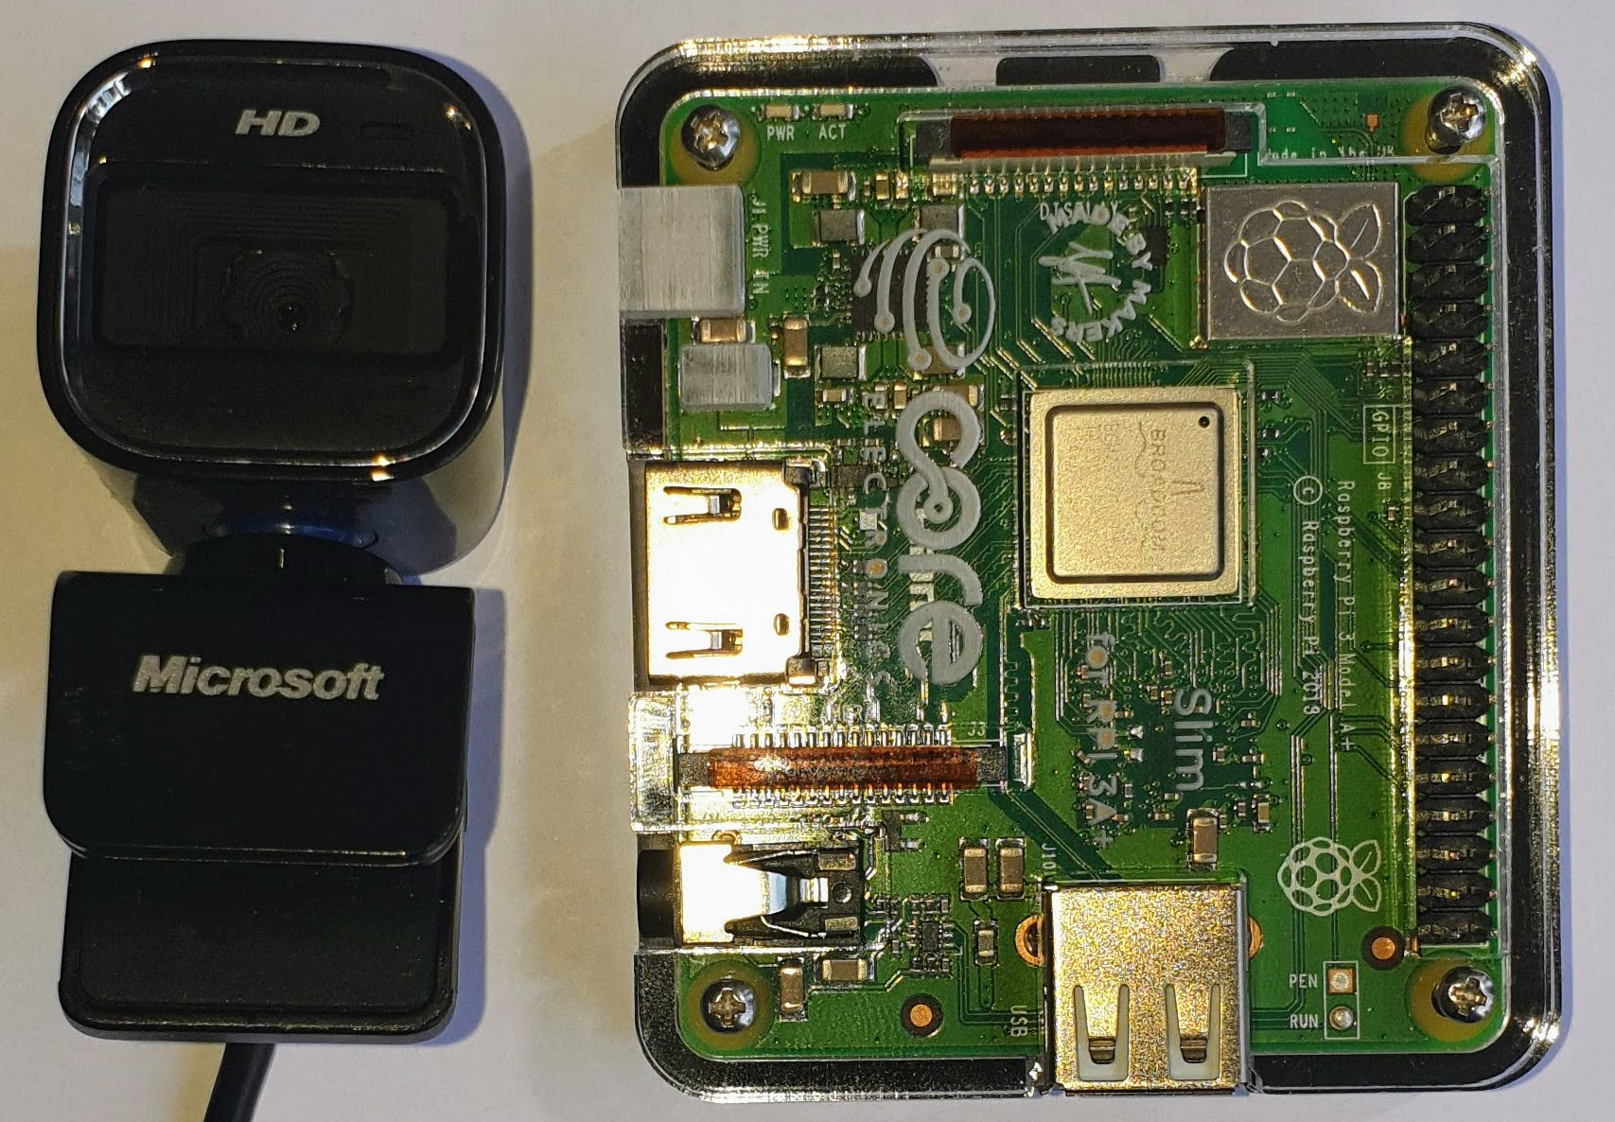
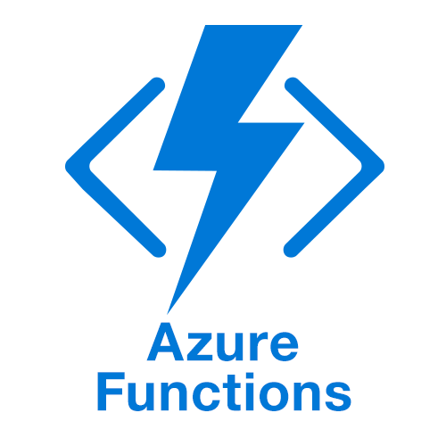
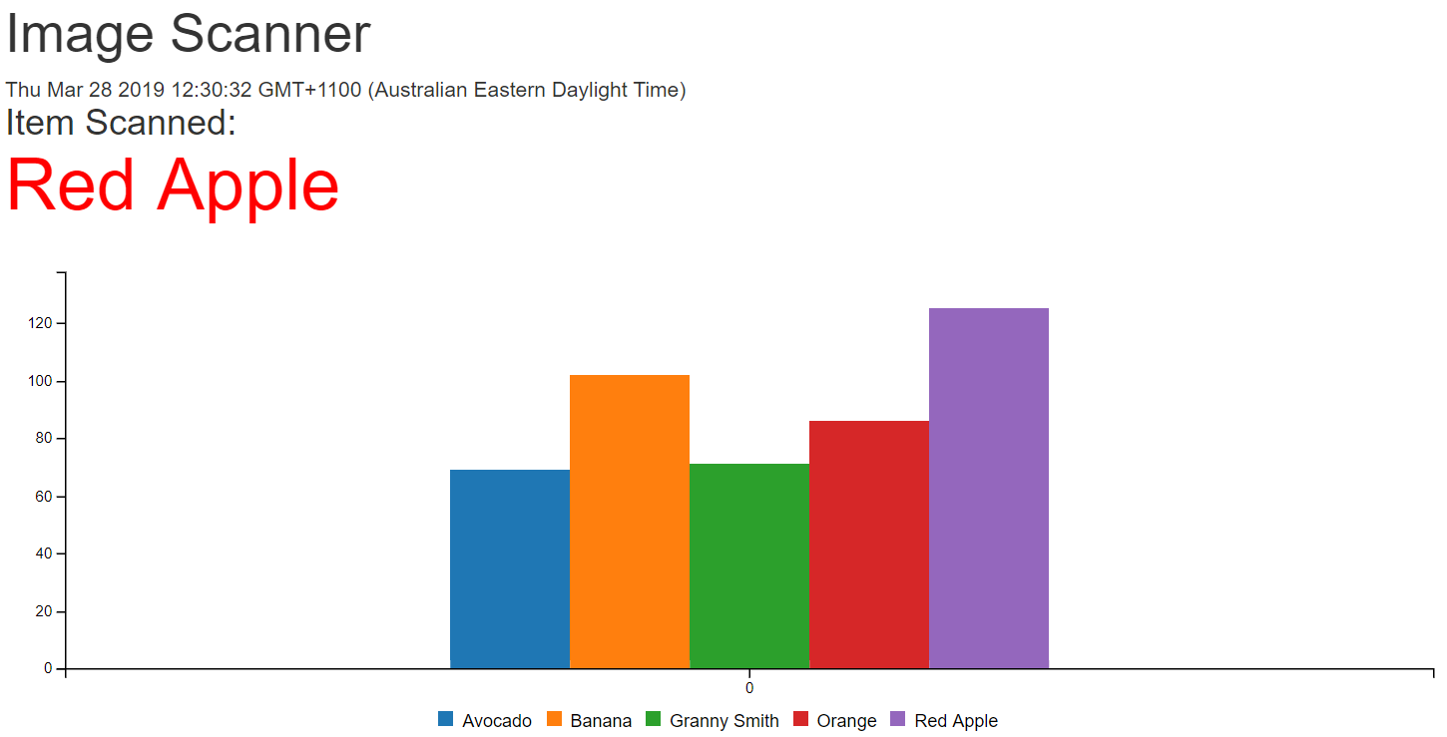
What we will cover
Python Image Recognition
(Azure IoT Edge)
Serverless & Azure Functions
Serverless Websites
(Azure Storage Static Websites)

Slide 4
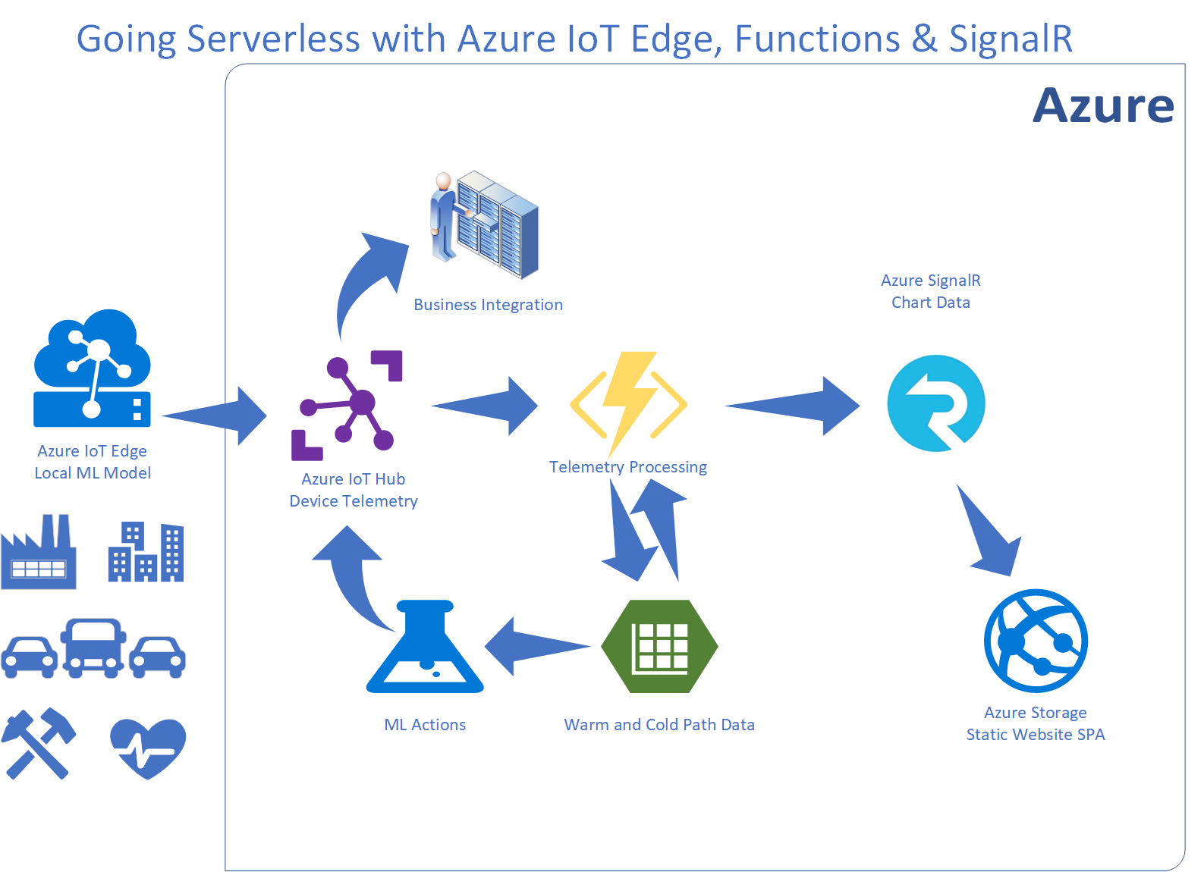
Integration IoT and Business

Slide 5
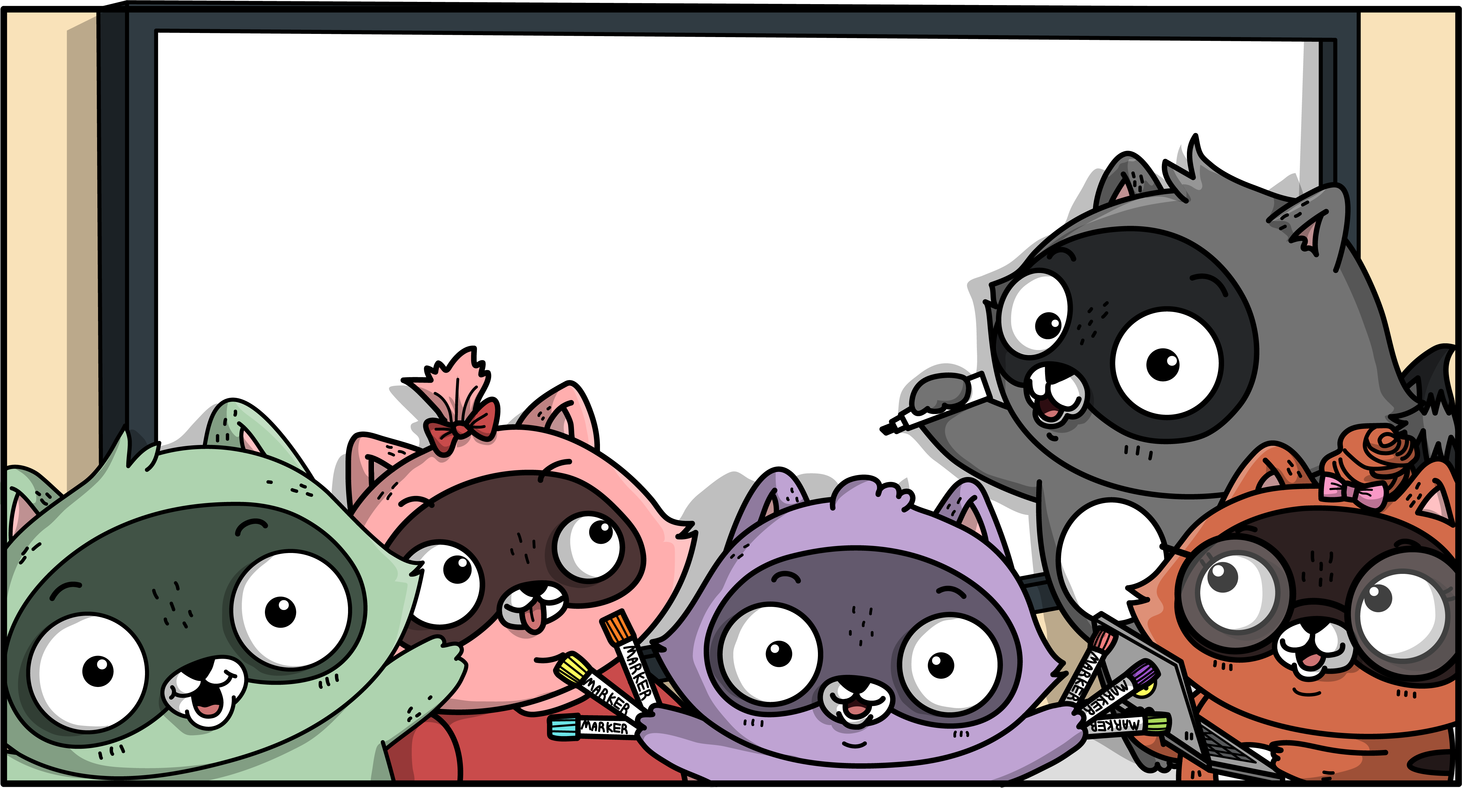
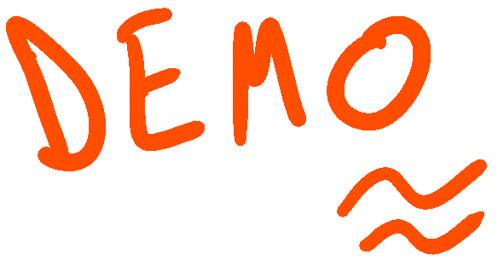

Slide 6
Python & Custom Vision AI and Azure IoT Edge

Slide 7
Python Image Recognition
Azure Custom Vision AI
Exported Python Container
Free Tier
https://www.customvision.ai/
Azure IoT Edge (IoT Hub)
Manages Deployment, Health, Updates
Docker Based
Open Source
Free Tier
Azure IoT Certified HW
Notes:
Peripheral nervous system: The portion of the nervous system that is outside the brain and spinal cord. Abbreviated PNS. The nerves in the PNS connect the central nervous system (CNS) to sensory organs, such as the eye and ear, and to other organs of the body, muscles, blood vessels, and glands. The peripheral nerves include the 12 cranial nerves, the spinal nerves and roots, and the autonomic nerves. The autonomic nerves are concerned with automatic functions of the body, specifically with the regulation of the heart muscle, the tiny muscles that line the walls of blood vessels, and glands.

Slide 8
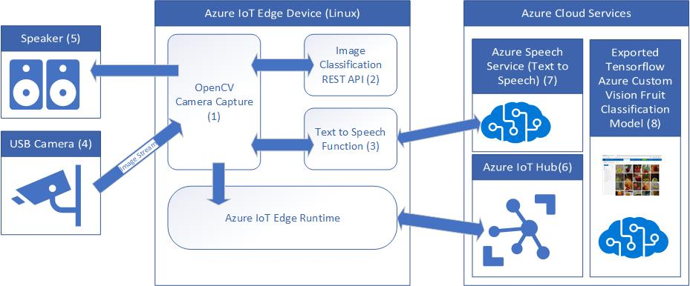
Visually Impaired Shopping Scenario

Slide 9
Azure IoT Hub in the Cloud and on the Edge
Azure IoT Hub in the Cloud
Internet Scale Device Support
Remote monitoring and management
Infinite Compute and Storage for Workloads such a Machine Learning & LOB
Azure IoT Edge
Low latency requiring near real-time response
Large quantities of data eg Image processing
Protocol translation & data normalization

Slide 10






Azure IoT Edge in Action
Develop your Container Workloads
Upload Modules to a Container Registry
Provision IoT Edge Device Agents
Select Device/Deployment Set
Define Modules
Define Message Routes
Define Module Parameters
Container Registry
Azure IoT Hub
IoT Edge
Container
Module
Container
Module
Container
Module
Container
Module
Module Twin
Device Twin
Module
Routes
Edge runtime
Local storage
Device Provisioning
Security Manager
Secure Boot
Secure Storage
Hardware based root of trust

Slide 12
Serverless with Azure Functions

Slide 13
What is Serverless?
No infrastructure headaches
Scales on demand
Very cheap to run

Slide 14

Functions as a Service (FaaS)
Functions as a Service
Single Responsibility, Short Lived, Stateless, Event Driven & Scalable
Azure Functions (Implementation of FaaS)
Great Local Developer Experience
Hosting Flexible
Consumption Plan, App Service Plan, Premium, and Container
Consumption plan
Free grant of 1 million requests and 400,000 GBs per month
Open Source https://github.com/Azure/Azure-Functions

Slide 15
Notes:
Using Visual Studio Code to build Python Functions
Debugging Experience
Deploying to Azure

Slide 16
Serverless Web Pages & Azure SignalR

Slide 17


SignalR in Action
Azure IoT Hub
Azure Function
Telemetry Processor
Azure SignalR Service
Browser
Desktop
Mobile
Game
Event Hub Trigger
SignalR Output Binding
WebSocket, Server Sent Events,
and Long Polling

Slide 18
Notes:
SignalR Trigger
Azure Storage Static Websites and Single Page Apps

Slide 19
Azure Machine Learning Studio

Slide 20
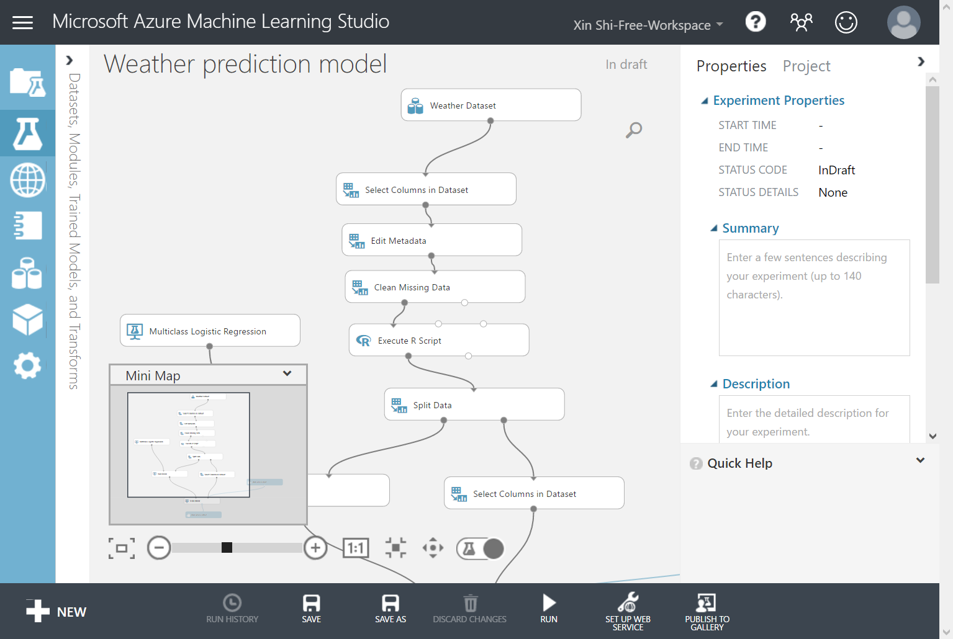
Machine Learning Studio
Weather forecast using the sensor data from your IoT hub in Azure Machine Learning

Slide 21
Session Summary

Slide 22
Resources
Create your first Python function in Azure
Azure Custom Vision AI
Azure SignalR Service Documentation
Static website hosting in Azure Storage
Demoed Solution on GitHub (gloveboxes)
Azure Functions Python Worker
Deploy Azure IoT Edge modules with Azure CLI
Weather forecast using the sensor data from your IoT hub in Azure Machine Learning

